Slide 1

Deep Dive INTO
EK-RA6M3 & EK-RA6M3G
RENESAS Advanced MCU KITS
Ashish AHUJA
PRINCIPAL PRODUCT MANAGER & PRODUCT MARKETING MANAGER
RENESAS ADVANCED (RA) MCU KITS
Disclaimer
Renesas Electronics & its affiliates do not make any warranty of accuracy, usefulness, certainty or any other kind, relating to the contents & any other information in this presentation (hereinafter "Contents").The Contents including but not limited to physical & electrical specifications/characteristics of products, block diagrams, etc. are subject to change without any notice. In no event shall Renesas Electronics & its affiliates be liable for any loss, expense or damage arising out of or in connection with the use of or reliance upon the Contents. Please refer to the product datasheet & user manual for the most accurate information for the purpose of planning & developing your product.
All product & company names & logos are trademarks™ or registered® trademarks of their respective holders.
Picture: Niagara Falls | Canada

Slide 2




AGENDA
Vision & Objective
of New RA Kits
Architecture
Features & Benefits
Deep Dive
Kit Features &
User Experience
Getting Started
Quickly

Slide 3
VISION OF RA KITS
Deliver an unmatched innovation experience
through scalable, flexible & ecosystem-ready Renesas Advanced MCU kits that enable users to bring their innovative products to market faster.

Slide 4








OBJECTIVE
To enable a large number of use cases so
customers, engineers, developers, distributors, partners, etc.
can do more
Proof-of-Concepts
Functional Evaluation
Getting Started Reference
Solutions &
Demos
Trainings & Workshops
Maker Community
Research & Academia
Promotions &
Lead Generation

Slide 5
STRATEGY
Biz.
Tech.
RA
Kits
Typical Development Kit
UX
Complexity of a MCU kit
Typical Starter Kit
Business
Serve global customer base
Facilitate cross-selling
Lower NRE & faster time to market
Technical
Useful for innovation
Support prioritized MCU peripherals
Ecosystem ready
User Experience
Delightful to use
Beautifully designed & presented
RA
Kits
Typical Breakout Board Kit
Number of business enablement use-cases supported
Size of the circle => Number of MCU features supported by the kit
All MCU features

Slide 6








DIFFERENTIATION that sets you apart
Innovation
Ready
Ecosystem
Ready
World
Ready
Fun
Ready
A winning combination of standardization & flexibility
Enhance functionality
on your terms
Compliant with many international standards
Take the guesswork out of your innovation experience

Slide 7
KIT ARCHITECTURE
Ecosystem & System Control Access Area
Power
Debug
Ecosystem expansion
Basic connectivity
User I/Os
Kit Information
Key Features of Architecture
Scalable design framework
Feature access organization
On-board access to most-popular ecosystems
Benefits of Architecture
Applicable across RA MCUs – new kits
Shorter learning curve for users
Improved user experience
Maximize hardware design reuse
Lower NRE
Faster time to market
Brings more innovation to users
Allows for vast functionality expansion
Fuels partner engagement and ecosystem utilization
Standard section
Special Feature Access Area (optional)
High value functionality
MCU Native Pin Access Area
Flexible section
(MCU dependent)
MCU pins
MCU current measurement
Other MCU dependent functionality

Slide 8
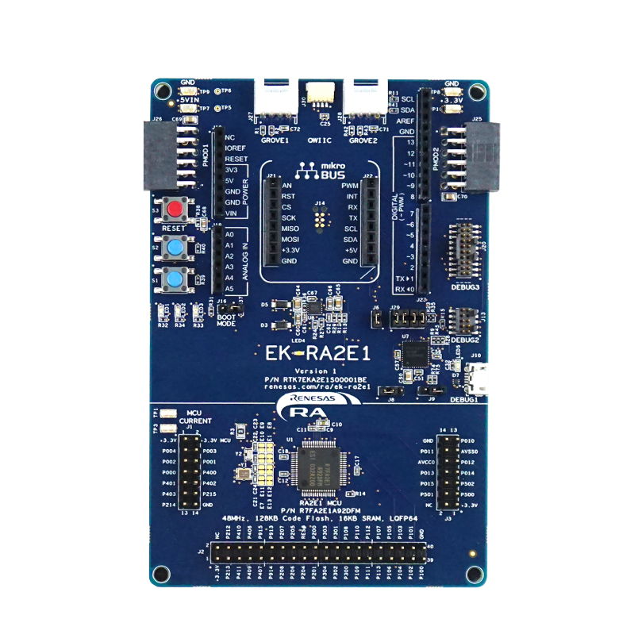
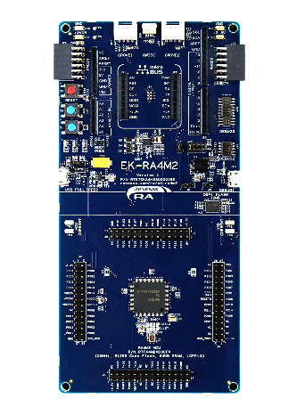
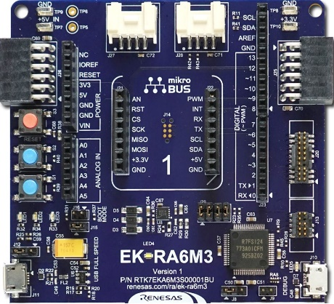
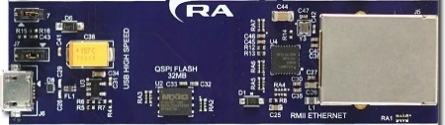
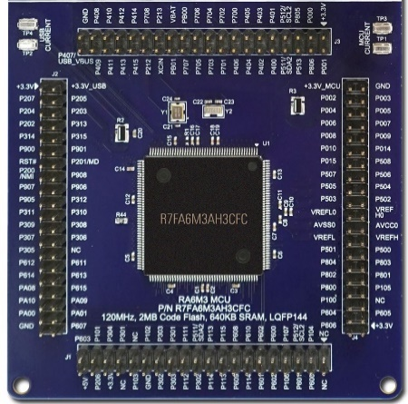
KIT ARCHITECTURE
Ecosystem & System Control Access Area
Power
Debug
Ecosystem expansion
Basic connectivity
User I/Os
Kit Information
Standard section
Special Feature Access Area (optional)
High value functionality
MCU Native Pin Access Area
Flexible section
(MCU dependent)
MCU pins
MCU current measurement
Other MCU dependent functionality
R7FA6M4AF3CFB
176
EK-RA6M3 Board
EK-RA4M2 Board
EK-RA2E1 Board

Slide 9
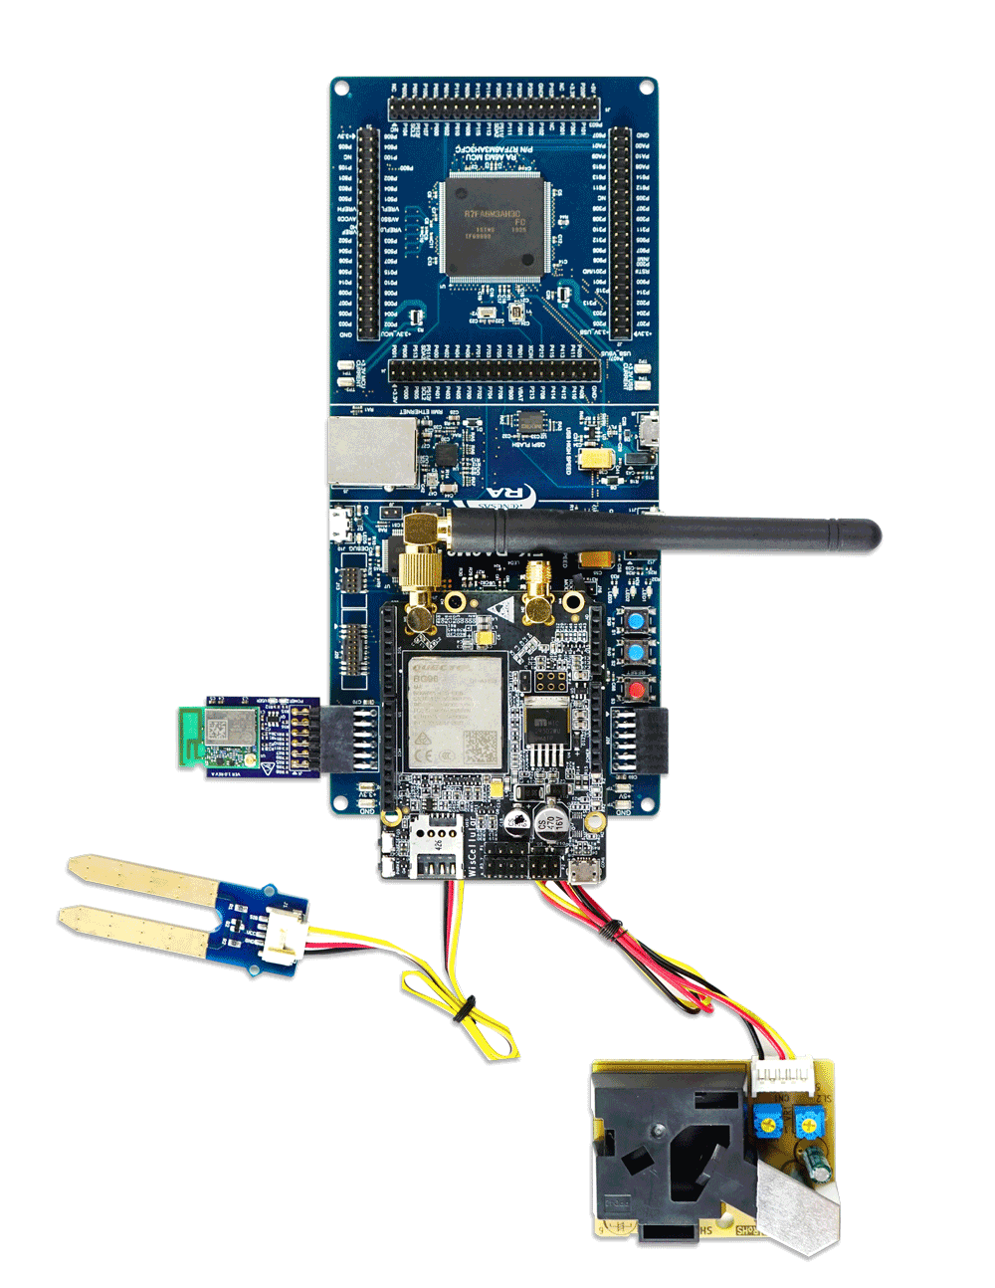
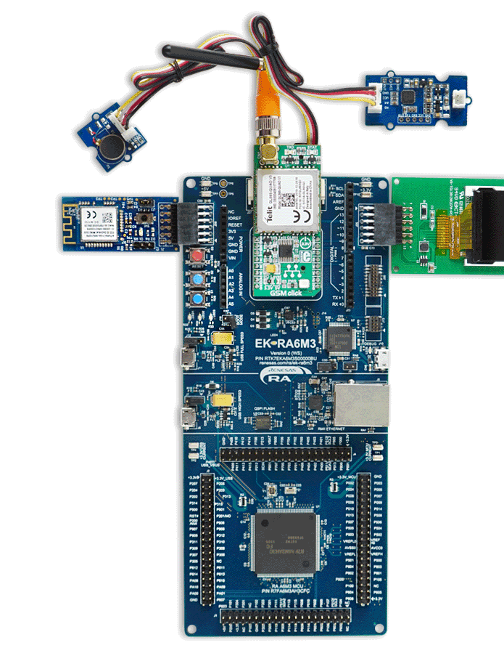

KIT ARCHITECTURE
Ecosystem & System Control Access Area
Power
Debug
Ecosystem expansion
Basic connectivity
User I/Os
Kit Information
Standard section
Special Feature Access Area (optional)
High value functionality
MCU Native Pin Access Area
Flexible section
(MCU dependent)
MCU pins
MCU current measurement
Other MCU dependent functionality
Connect RA kits with ecosystem add-ons to enhance the functionality to support variety of end-applications

Slide 10
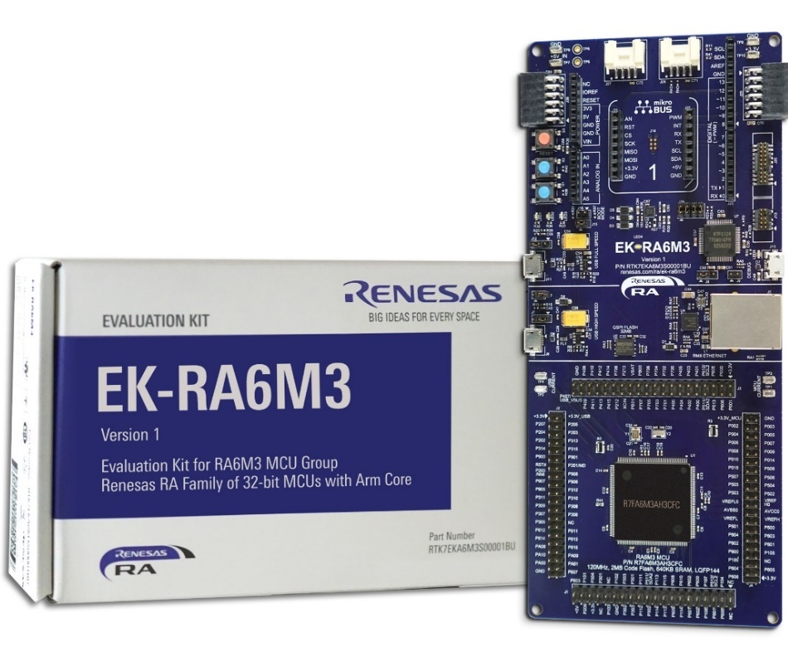
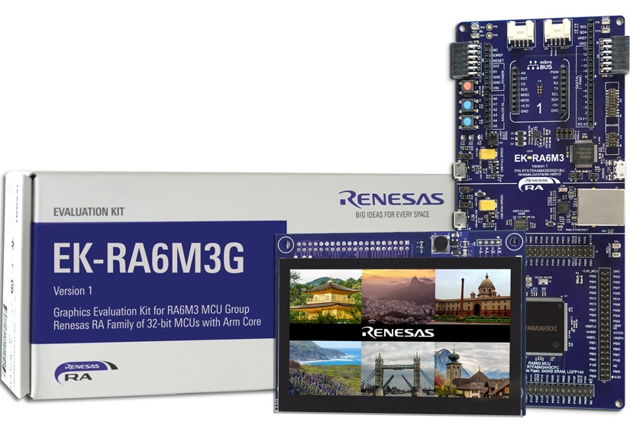
THE WORLD OF INNOVATION AWAITS You!
EK-RA6M3
Evaluation Kit for RA6M3 MCU Group
EK-RA6M3G
Graphics Evaluation Kit for RA6M3 MCU Group

Slide 11
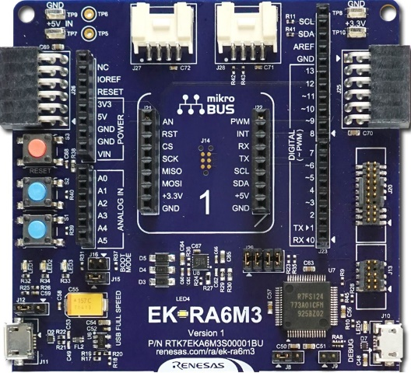
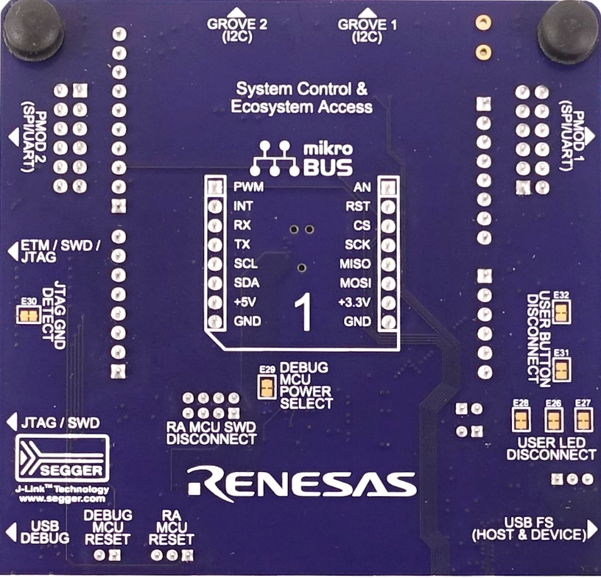

ECOSYSTEM & SYSTEM CONTROL ACCESS AREA
Power
Multiple power inputs
  USB debug
  USB full speed
  USB high speed (not shown)
  Clamping loops
  Through-hole points
On-board LDO 5 V to 3.3 V, 2 A
3.3 V test clamping loop
Power LED (white)
Superimpose currents by connecting multiple power sources simultaneously
S124
Debug
MCU
Front
Back

Slide 12
ECOSYSTEM & SYSTEM CONTROL ACCESS AREA
Debug & Trace
S124 debug MCU
Segger J-LinkTM firmware
Debug connectors
  Micro USB (SWD)
  10-pin Cortex (SWD, JTAG)
  20-pin Cortex (SWD, JTAG, ETM)
Debug status LED (orange)
  Solid – debug drivers detected
  Blinking - debug drivers not detected
Debug modes selection jumpers
S124
Debug
MCU
Front
Back

Slide 13
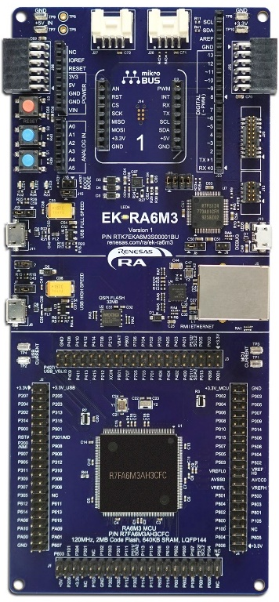


Multiple Debug MODES
Debug On-Board
Debug In
Debug Out
RA
External
Debugger
S124
S124
RA
RA
176
176
176
Interface: SWD
Connector: USB Debug
Interface: SWD, ETM, JTAG
Connectors: 10-pin, 20-pin
Interface: SWD
Connectors: USB Debug, 10-pin, 20-pin

Slide 14
ECOSYSTEM & SYSTEM CONTROL ACCESS AREA
Ecosystem Expansion
2 SeeedGrove® system (I2C)
2 Digilent PmodTM (SPI & UART)
ArduinoTM (Uno R3)
MikroElektronikaTM mikroBUS
User I/O
3x User LEDs (red, blue, green)
2x User buttons (blue)
Disconnect traces
S124
Debug
MCU
Front
Back

Slide 15
ECOSYSTEM & SYSTEM CONTROL ACCESS AREA
Serial Connectivity
SPI, I2C and UART through ecosystem headers
USB full speed (host & device)
  Micro AB connector
System Control
Reset button (red)
Boot configuration jumper
Others
Kit information area
  Version number
  Orderable part number
  Website
S124
Debug
MCU
Front
Back

Slide 16
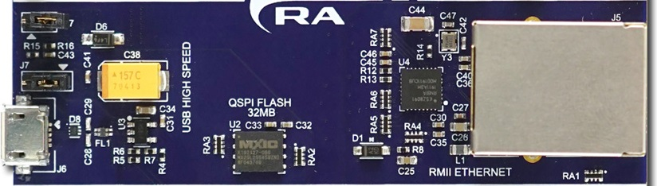
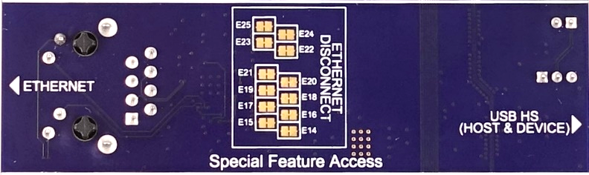
SPECIAL FEATURES ACCESS AREA
High Speed Connectivity
Ethernet PHY
  RJ45 with integrated magnetics
  RX & TX LEDs
  RMMI disconnect traces
USB high speed (host & device)
  Micro AB connector
32 MB QSPI flash
Front
Back

Slide 17

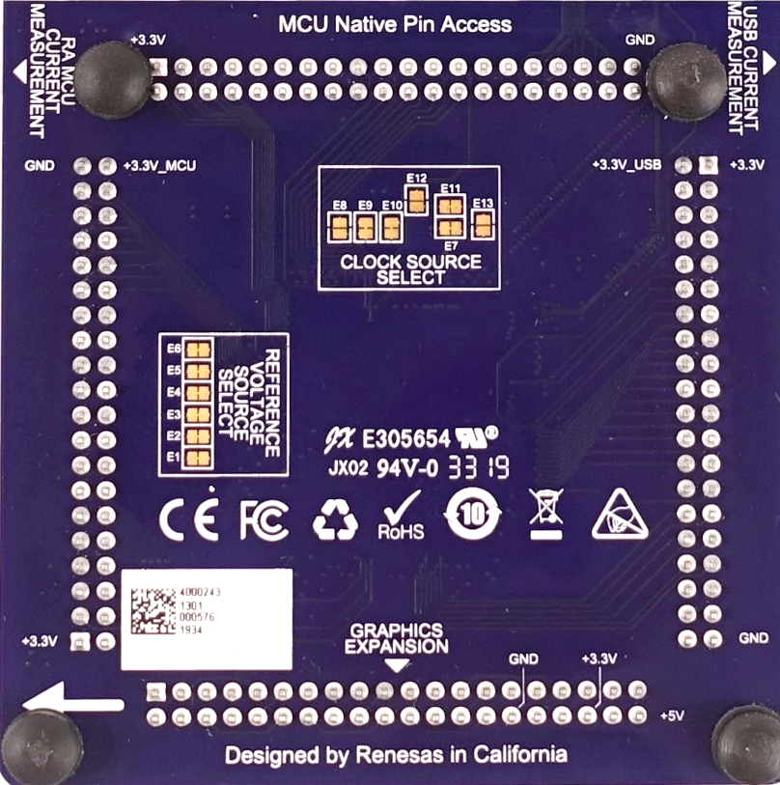

MCU NATIVE PIN ACCESS AREA
RA6M3 MCU
R7FA6M3AH3CFC
MCU Breakout pins
4x 40-pin male headers
3.3 V & ground available on each header
Graphics expansion port (J1)
RA6M3 MCU
176
Front
Back

Slide 18
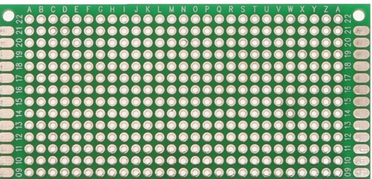
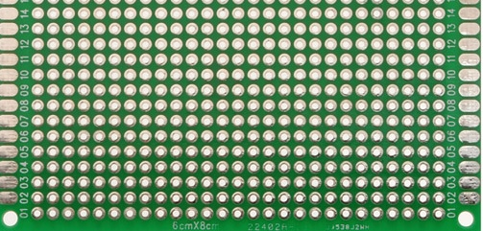
MCU NATIVE PIN ACCESS AREA
RA6M3 MCU
R7FA6M3AH3CFC
MCU Breakout pins
4x 40-pin male headers
3.3 V & ground available on each header
Graphics expansion port (J1)
Enhanced prototyping support
Keyed to prevent incorrect insertion of custom daughter boards
RA6M3 MCU
176
Front
Back

Slide 19
MCU NATIVE PIN ACCESS AREA
RA6M3 MCU
R7FA6M3AH3CFC
MCU Breakout pins
4x 40-pin male headers
3.3 V & ground available on each header
Graphics expansion port (J1)
Enhanced prototyping support
Keyed to prevent incorrect insertion of custom daughter boards
Current Measurement
MCU & USB current
Others
Clock generation & source selection
Reference voltage selection traces
RA6M3 MCU
176
Front
Back

Slide 20
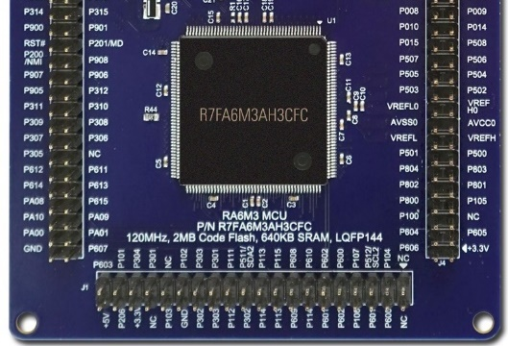


Graphics Expansion BOARD
Key Features
Specifications
4.3 inch TFT color LCD
480 x 272 resolution
Capacitive touch overlay with controller
Back light controller
Connected to J1 40-pin header of EK-RA6M3 board
Availability
Included only in EK-RA6M3G
Not sold individually
176
Graphics Expansion Board
Included in EK-RA6M3G

Slide 21
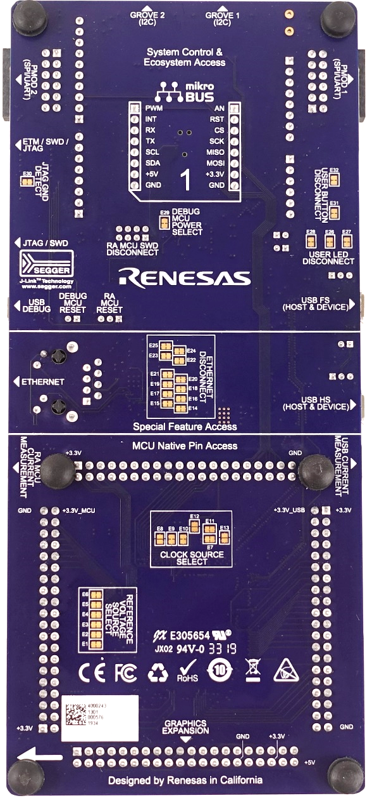

UX ENHACEMENTS
1. Practical & Aesthetic Layout & Placement
Design symmetry & segmentation
Connectors & button placement along the PCB edges for convenient access
Prototyping friendly break-out connector
Vertical & horizontal placement alignment
Clamping connectors – clamp, solder, contact
Simultaneous use of multiple features
  Except Arduino & MikroBUS connectors due to physical limitations
176
Front
Back

Slide 22
UX ENHACEMENTS
1. Practical & Aesthetic Layout & Placement
Design symmetry & segmentation
Connectors & button placement along the PCB edges for convenient access
Prototyping friendly break-out connector
Vertical & horizontal placement alignment
Clamping connectors – clamp, solder, contact
Simultaneous use of multiple features
  Except Arduino & MikroBUS connectors due to physical limitations
2. “Using” & “Buying” Friendly Silk Screen
Consistent font type & size
Descriptive labeling
Vertical & horizontal text alignment & rotation
Help text – URLs, MCU & kit orderable part numbers, version number, compliance logos, serial number, etc.
176
Front
Back

Slide 23
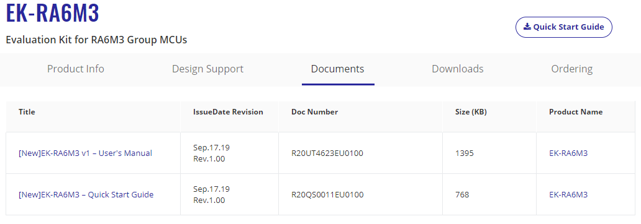
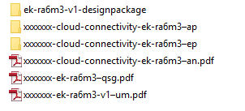
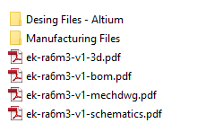
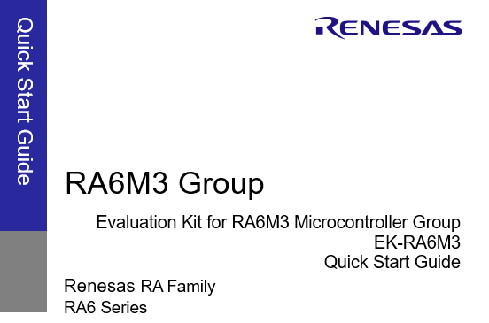
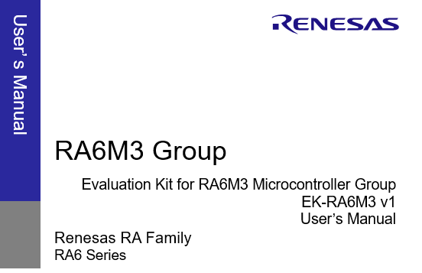
UX ENHACEMENTS
3. Website
renesas.com/ra/<kitname>
Easy to find collateral
Easy to order – live distributor stock
Consistently & professionally branded
High resolution pictures
4. Print Collateral
Consistently & professionally branded
Extensive & well-structured documentation
Consistent & intuitive file/folder nomenclature
  Kit name
  Document type
Easy to find stuff
Easy to order
Consistently & professionally branded documentation
Intuitive & consistent file & folder nomenclature

Slide 24
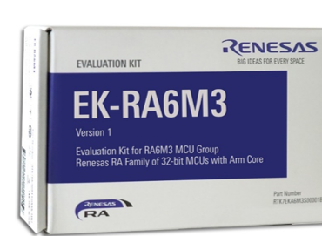
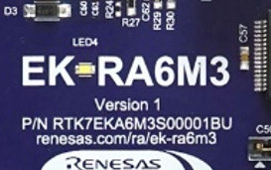
UX ENHACEMENTS
5. Version Synchronization
Across All Version-specific Collateral
User’s manual
Kit board
Orderable part number
Packaging
Design package
  3D drawings
  BOM
  Mechanical drawings
  Schematics
Exclusions
  Quick start guide
Case-by-case exceptions
  Example projects
  Application notes
  Application projects
Website
Packaging
User’s manual
Kit version number & orderable part number
All version-specific collateral

Slide 25
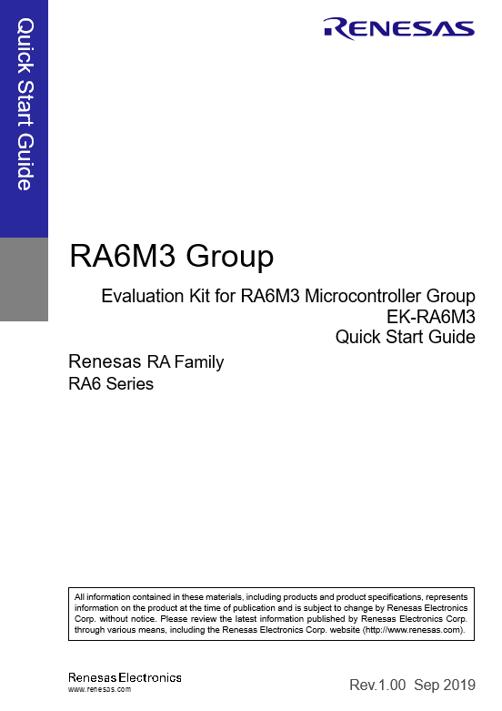









WORLD READY
Certifications
EMC/EMI Standards
FCC Notice (Class A) – Part 15
Innovation, Science and Economic Development Canada ICES-003 Compliance: CAN ICES-3 (A)/NMB-3(A)
CE Class A (EMC Directive 2004/108/EEC)
Taiwan Chinese National Standard 13438, C6357 compliance, Class A limits
Australia/New Zealand AS/NZS CISPR 32:2015, Class A
Waste, Recycling and Material Selection
EU RoHS
China SJ/T 113642014, 10-year environmental protection use period
Safety Standards
UL 94V-0
User’s manual & quick start guide available in English & Japanese

Slide 26




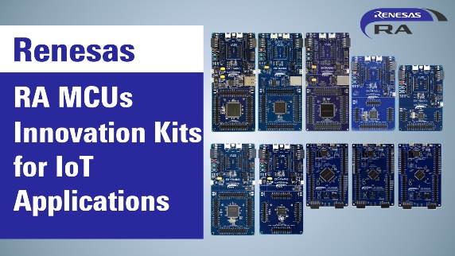





TOP NOTCH COLLATERAL (PPts, VIDEOS)
Click the thumbnails to view videos
Presentations and videos are available on renesas.com/ra/ek-ra6m3

Slide 27


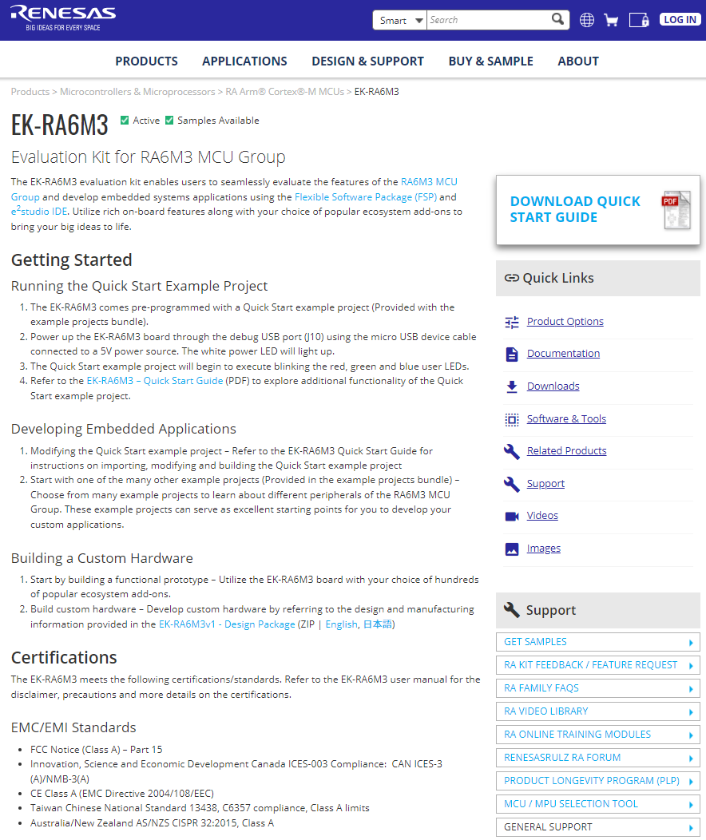
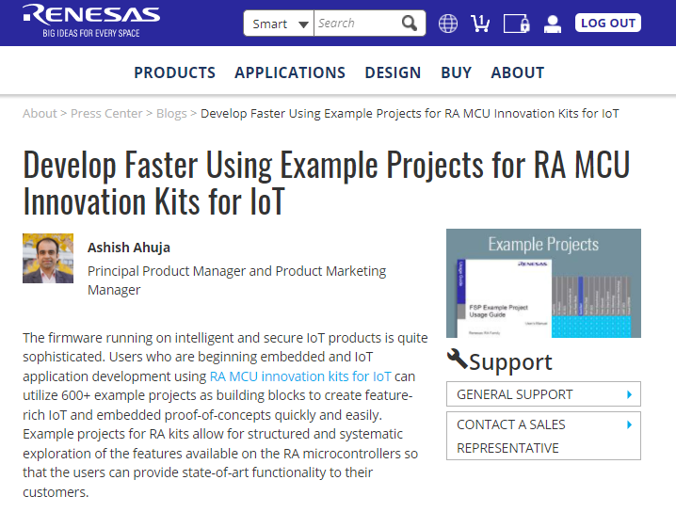
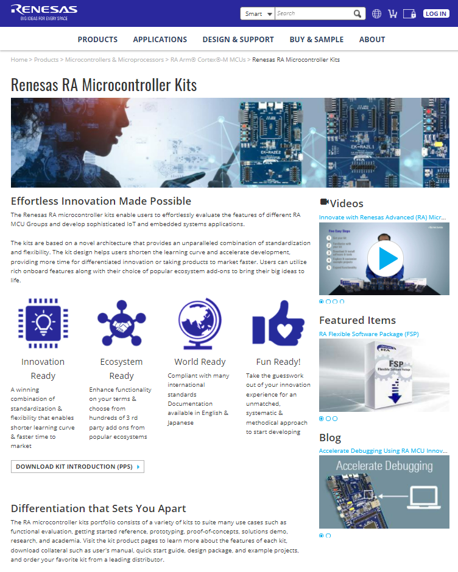
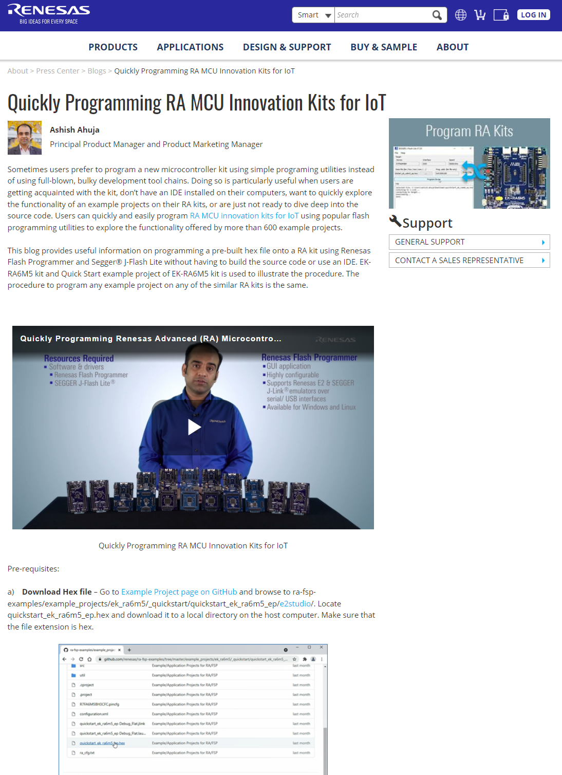
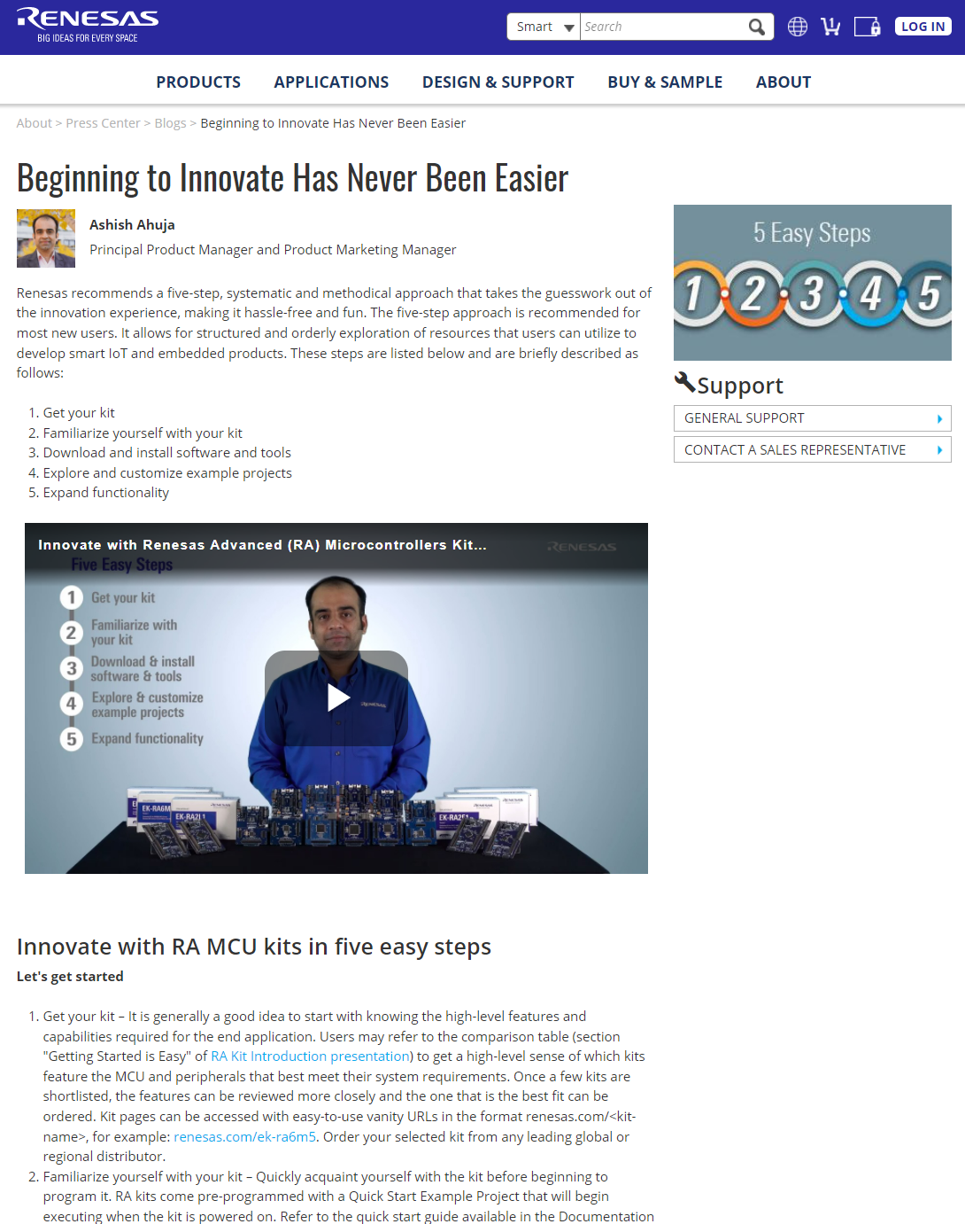
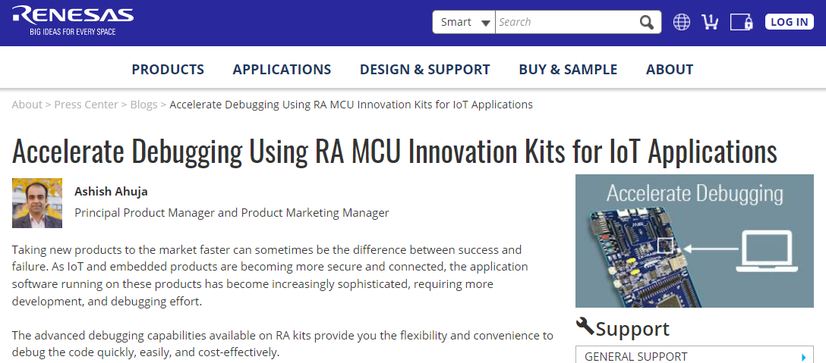
TOP NOTCH COLLATERAL (WEB, BLOGs)
EK-RA6M3 information and blogs are available on renesas.com/ra/ek-ra6m3
RA kit page renesas.com/ra/kits

Slide 28
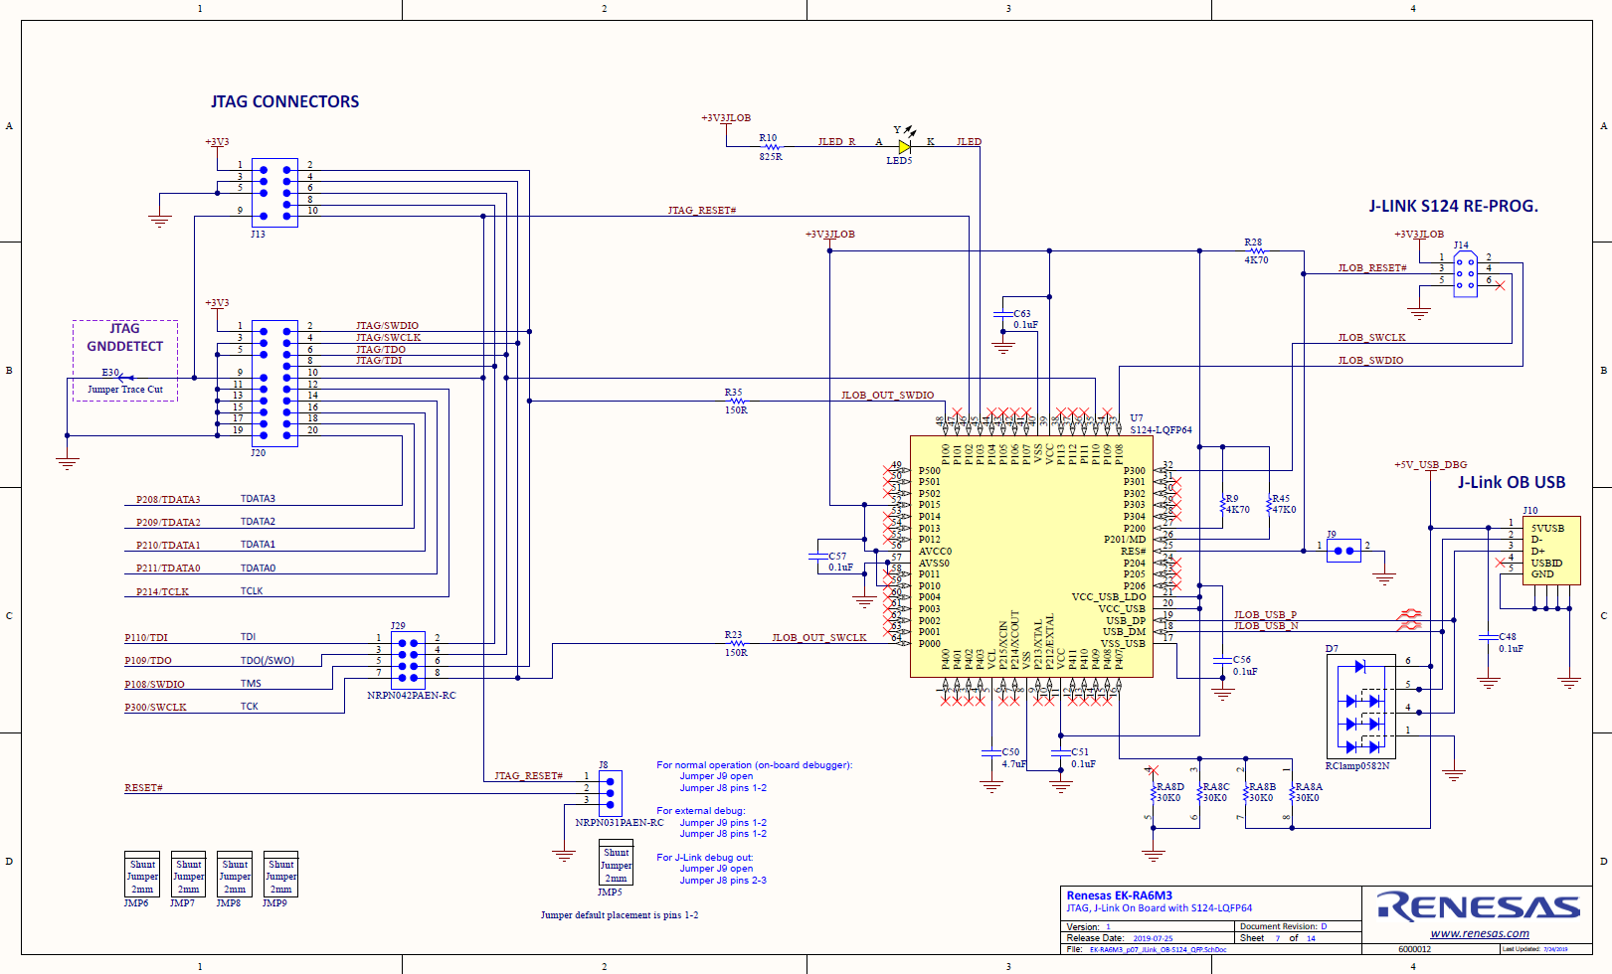
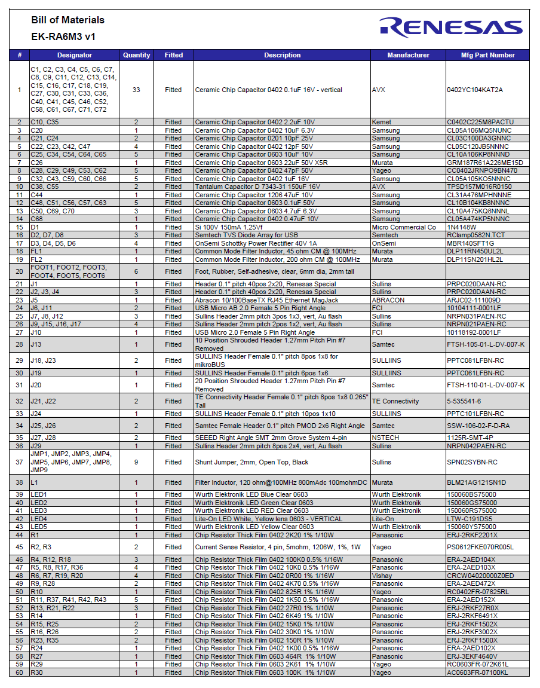
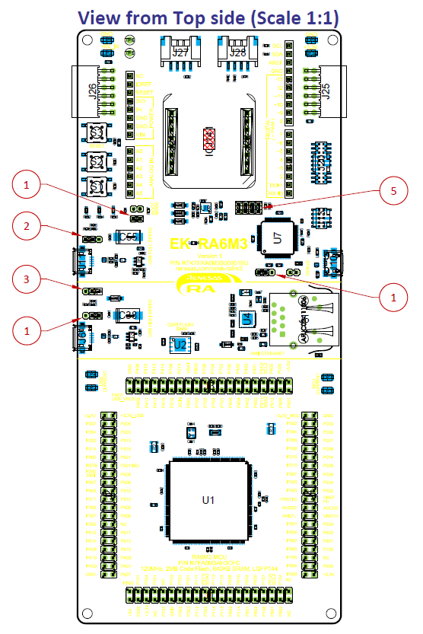
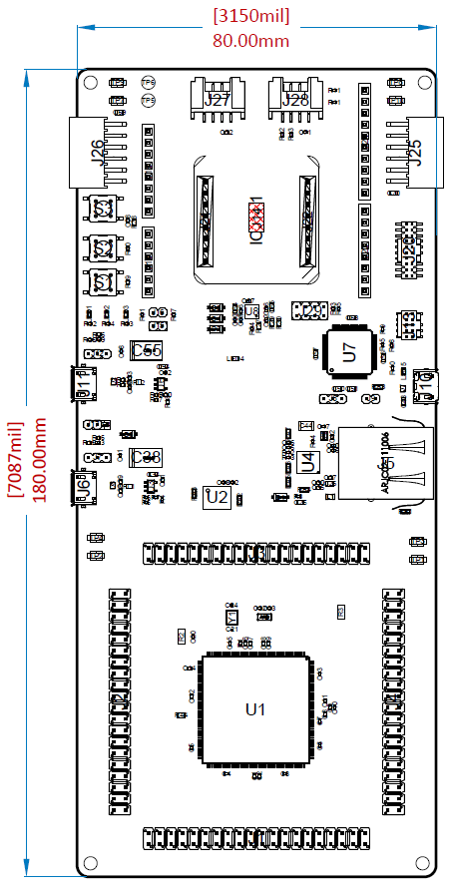

TOP NOTCH COLLATERAL - ENGINEERING
Design Package
Quick start
guide
User’s manual
Schematics
Bill of Materials
Design &
manufacturing files
Example Projects
All items are available on renesas.com/ra/ek-ra6m3

Slide 29
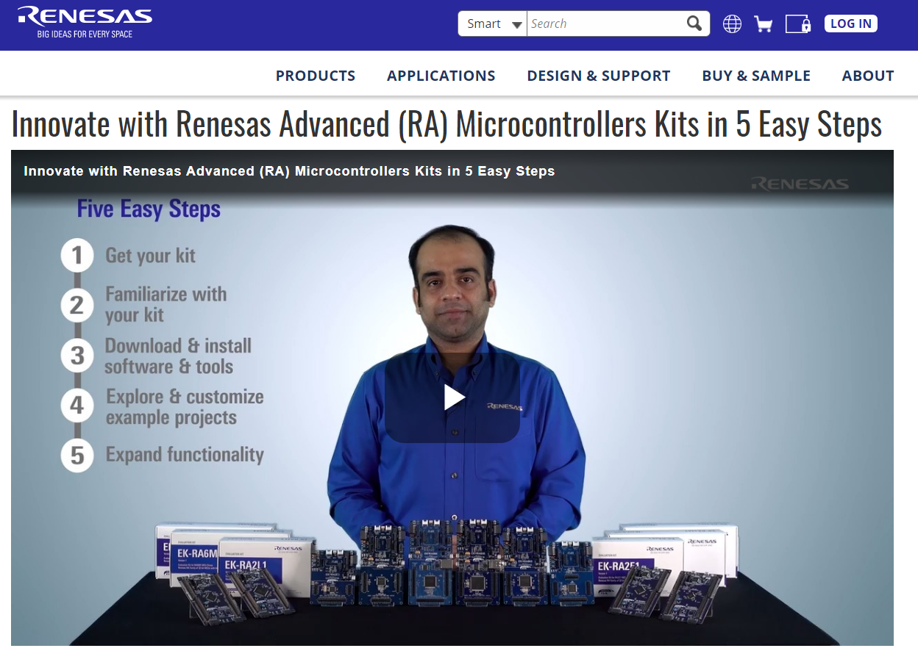
GETTING STARTED IS EASY!
Take the guesswork out of your innovation experience for an
unmatched, systematic & methodical approach to start developing
Watch the video
Click the image to watch the video

Slide 30



















GETTING STARTED IS EASY!
1
Choose your favorite kit
Order it from one of the leading global or regional distributors
Get your kit
Kit Name | Orderable Part Number | Kit Contents
EK-RA6M3G | RTK7EKA6M3S01001BU | EK-RA6M3 board, Graphics Expansion Board, USB device, USB host & Ethernet cables
EK-RA6M3 | RTK7EKA6M3S00001BU | EK-RA6M3 board, USB device, USB host & Ethernet cables
2
Familiarize with your kit
3
Download & install software & tools
4
Explore & customize example projects
5
Expand functionality
Sampling of distributors
(List subject to change; please refer to renesas.com/ra/ek-ra6m3 for the list of distributors stocking the kit)

Slide 31
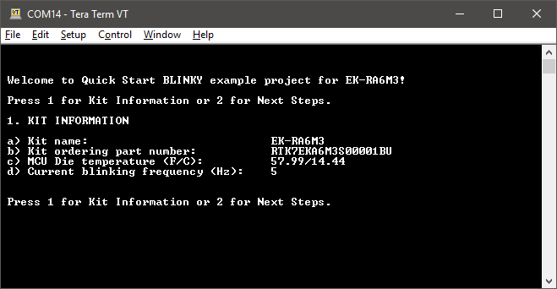
GETTING STARTED IS EASY!
1
Get quick start guide & user’s manual
Execute the Quick Start (QS) example project (EP) that is pre-programmed on the kit
Get your kit
Kit Name | Kit Homepage
EK-RA6M3 | renesas.com/ra/ek-ra6m3
EK-RA6M3G | renesas.com/ra/ek-ra6m3g
2
Familiarize with your kit
Quick start guide
User’s manual
3
Download & install software & tools
4
Explore & customize example projects
5
Expand functionality
Quick Start example project

Slide 32
GETTING STARTED IS EASY!
1
Download & install software & tools using the FSP with e² studio installer that includes:
  Flexible Software Package – includes Hardware Abstraction Layer (HAL) drivers, Board Support Package (BSP), libraries, etc.
  e2 studio – Integrated Development Environment
  Need help anytime?
  Ask questions, get answers from experts & collaborate with community
  renesas.com/ra/forum
Get your kit
2
Familiarize with your kit
Item | Download page
FSP with e² studio installer | renesas.com/ra/fsp
3
Download & install software & tools
4
Explore & customize example projects
5
Expand functionality

Slide 33
GETTING STARTED IS EASY!
1
Explore & customize Quick Start Example Project
  Visit EK-RA6M3 webpage renesas.com/ra/ek-ra6m3 and scroll down to “Documentation & Downloads” section
  Download EK-RA6M3 Example Project Bundle
  Extract the downloaded file xxxx-ek-ra6m3-exampleprojects.zip
  Browse to xxxx-ek-ra6m3-exampleprojects\ek_ra6m3\_quickstart\quickstart_ek_ra6m3_ep to locate the source code of the QS EP
  Refer to the quick start guide for instructions on modifying, rebuilding & programming the QS EP on your kit
Explore & customize additional Example Projects
  In the EK-RA6M3 Example Project Bundle downloaded in the step above, browse to xxxx-ek-ra6m3-exampleprojects\ek_ra6m3\ to locate the example projects provided for this kit
  Open xxxx-ek-ra6m3-exampleprojects.pdf to view the list of tool chain supported for each example project and additional reference documents
Get your kit
2
Familiarize with your kit
3
Download & install software & tools
4
Explore & customize example projects
5
Expand functionality

Slide 34















GETTING STARTED IS EASY!
1
Choose from hundreds of add-on modules from the supported ecosystems to build custom proof-of-concept hardware
Choose from numerous software IPs from Renesas ecosystem partners for additional features
Refer to the kit design package to develop your custom board with feature enhancements
Get your kit
2
Familiarize with your kit
3
Download & install software & tools
4
Explore & customize example projects
5
Expand functionality
Schematics
BOM
Design & manufacturing files

Slide 35






USEFUL RESOURCES
Ordering &
Documentation
Example Projects
Video
Library
Support
Community
Feedback &
Feature Requests
User Manual, Design Package, Quick Start Guide
renesas.com/ra/ek-ra6m3
Access FSP and Example Projects for RA Kits
renesas.com/ra/KitEP
Learn more about RA MCU,
Kits, FSP, and Tools
renesas.com/ra/videos
Ask questions from experts
Collaborate with community
renesas.com/ra/forum
Tell us how we are doing and how can enhance your experience
renesas.com/ra/KitFeedback

Slide 36

BRING YOUR BIG IDEAS TO LIFE
Unmatched Innovation Experience
renesas.com/ra/kits

Slide 37
renesas.com/ra/kits

