Slide 1

RA4M1 Clicker BOARD
OVERVIEW
Ashish AHUJA
PRINCIPAL PRODUCT MANAGER & PRODUCT MARKETING MANAGER
RENESAS ADVANCED (RA) MCU KITS
Disclaimer
Renesas Electronics & its affiliates do not make any warranty of accuracy, usefulness, certainty or any other kind, relating to the contents & any other information in this presentation (hereinafter "Contents").The Contents including but not limited to physical & electrical specifications/characteristics of products, block diagrams, etc. are subject to change without any notice. In no event shall Renesas Electronics & its affiliates be liable for any loss, expense or damage arising out of or in connection with the use of or reliance upon the Contents. Please refer to the product datasheet & user manual for the most accurate information for the purpose of planning & developing your product.
All product & company names & logos are trademarks™ or registered® trademarks of their respective holders.

Slide 2
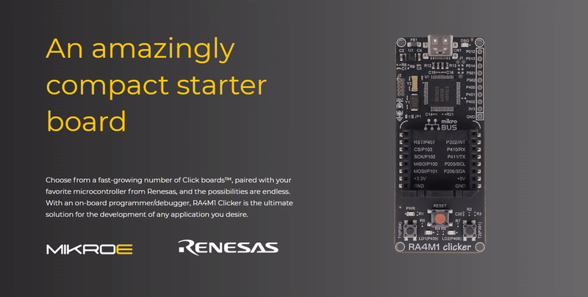
RA4M1 CLICKER by MIKROE

Slide 3
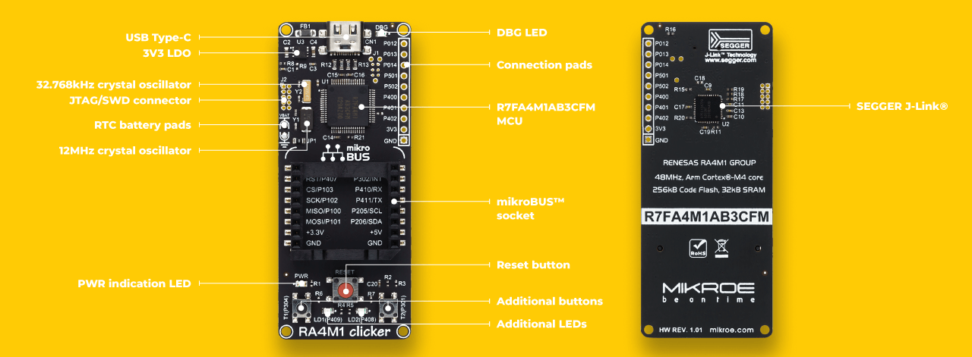
FEATURES

Slide 4
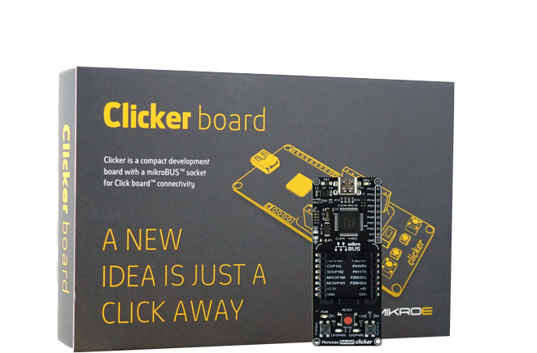
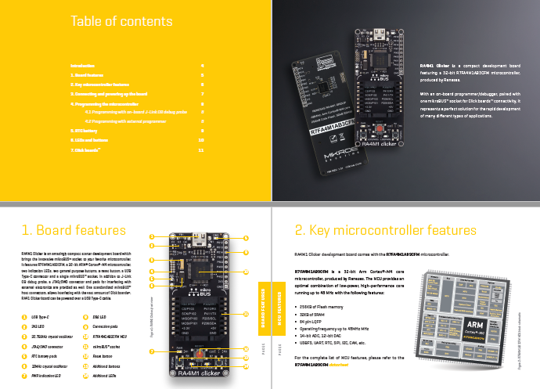
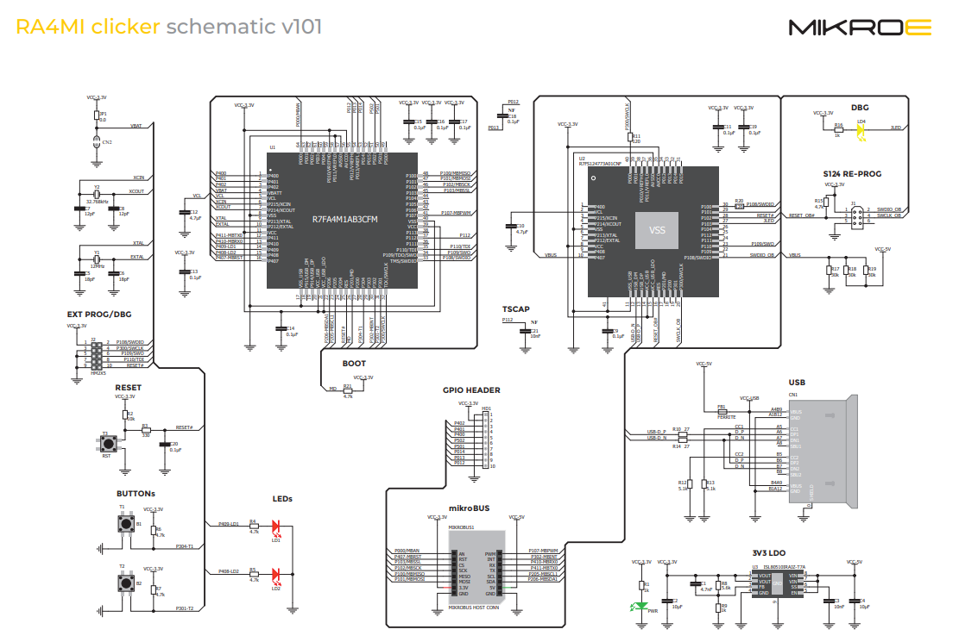
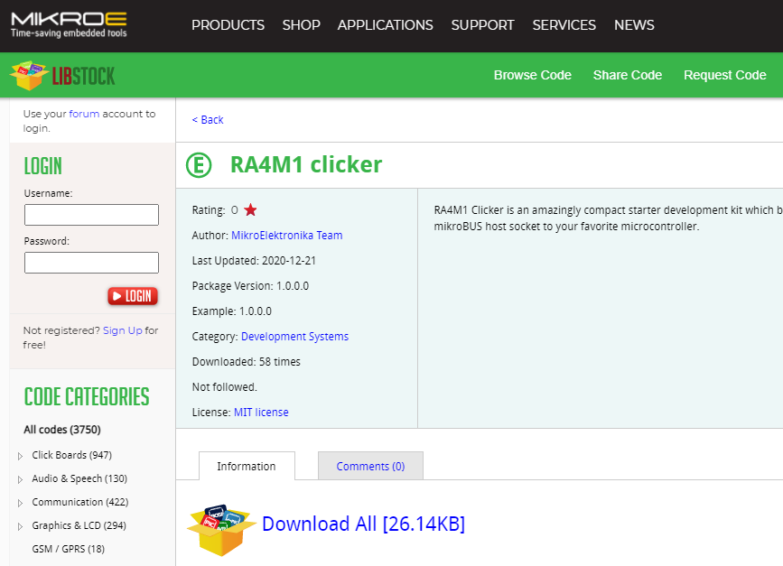

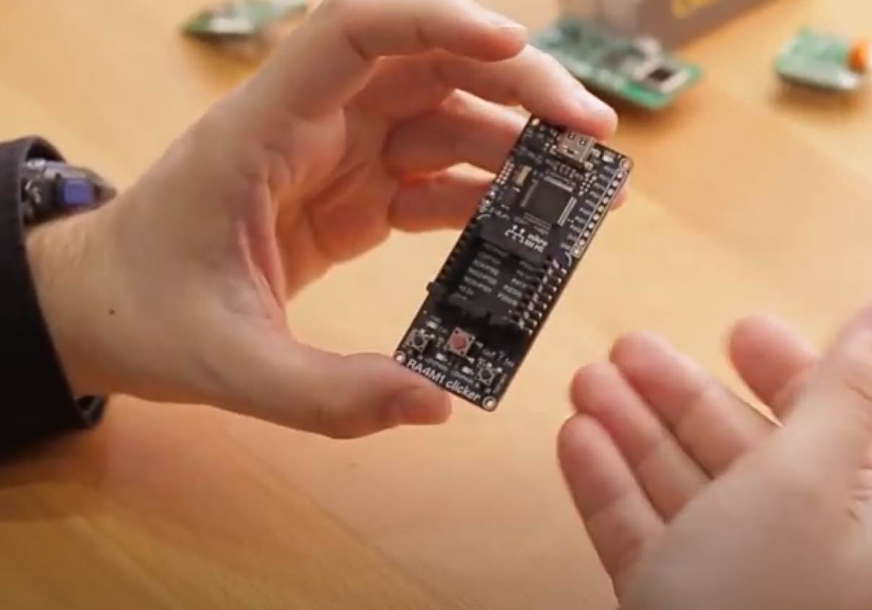
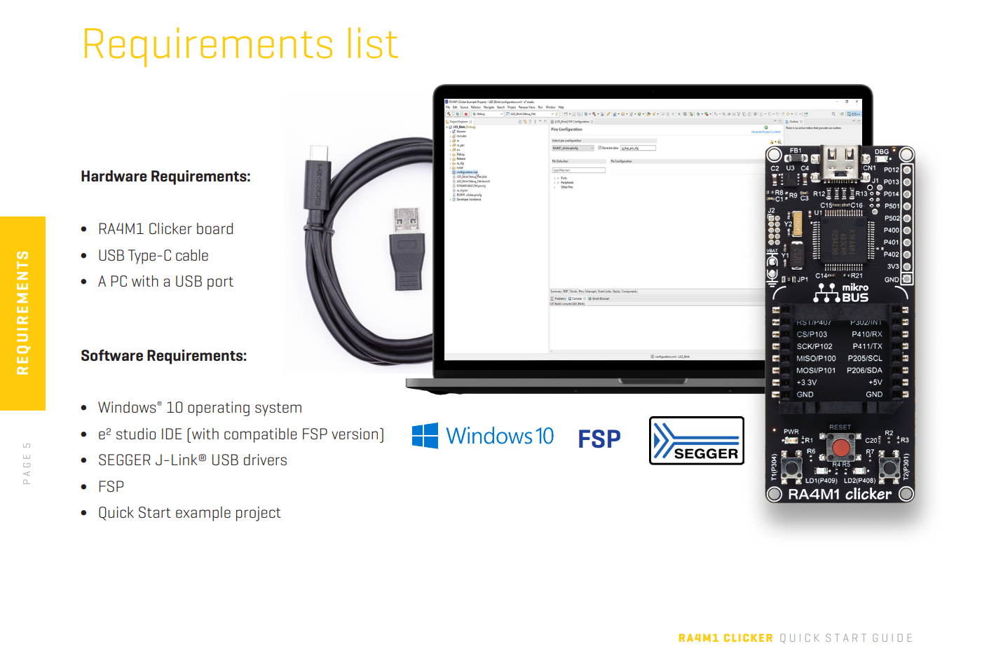

PARTER KITS – MIKROE – RA4M1 CLICKER
Mikroe.com/ra4m1-clicker
User Manual
Design Files and Schematics
Code Example
Quick Start Guide
Introduction Video

Slide 5
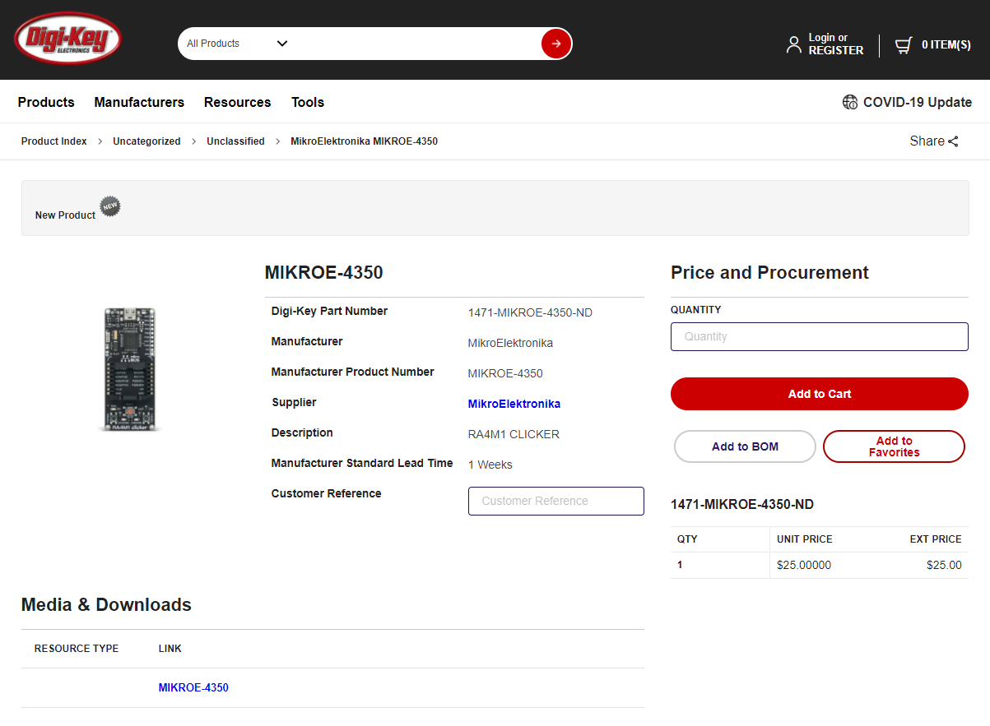
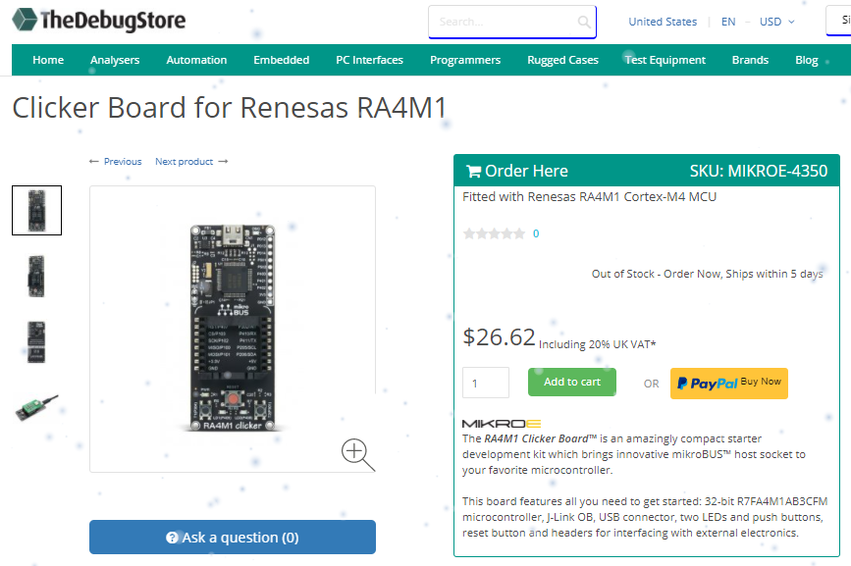
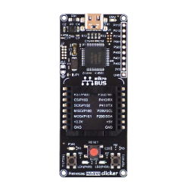
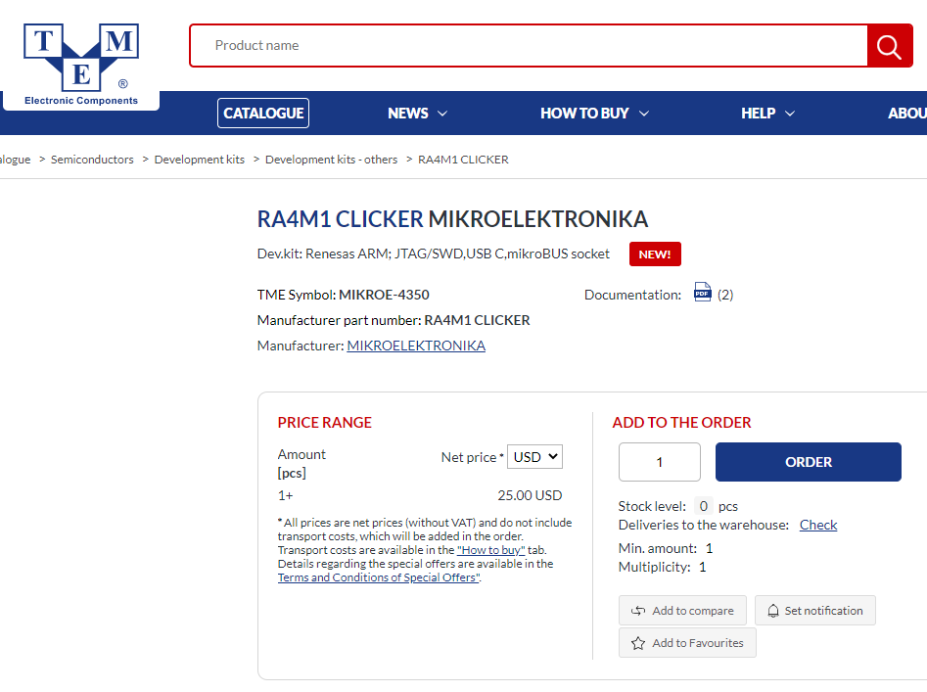
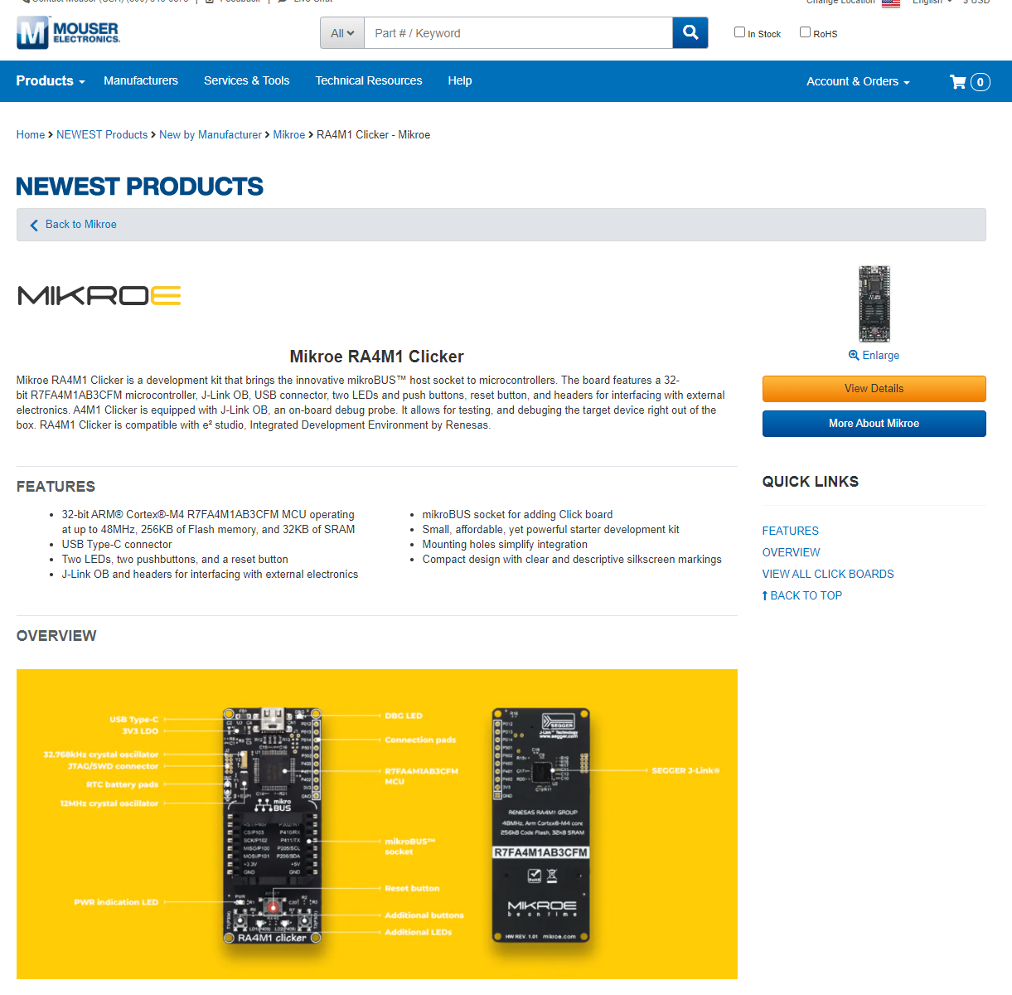
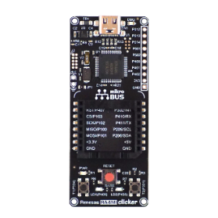
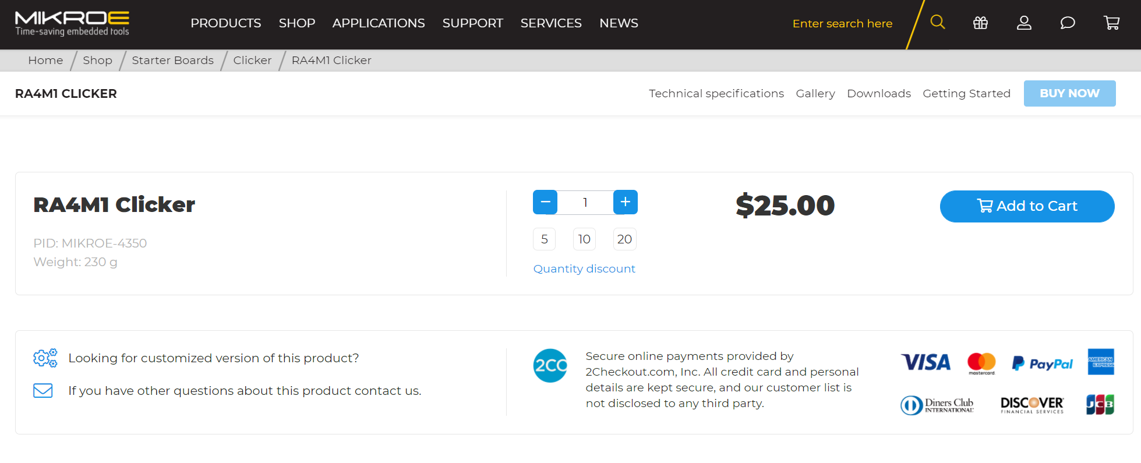
ORDERING INFO
  Ordering code: MIKROE-4350
  Order at:
    Mikroe online store
    Leading global and regional distributors - Mouser, DigiKey, RS Components, etc.

Slide 6
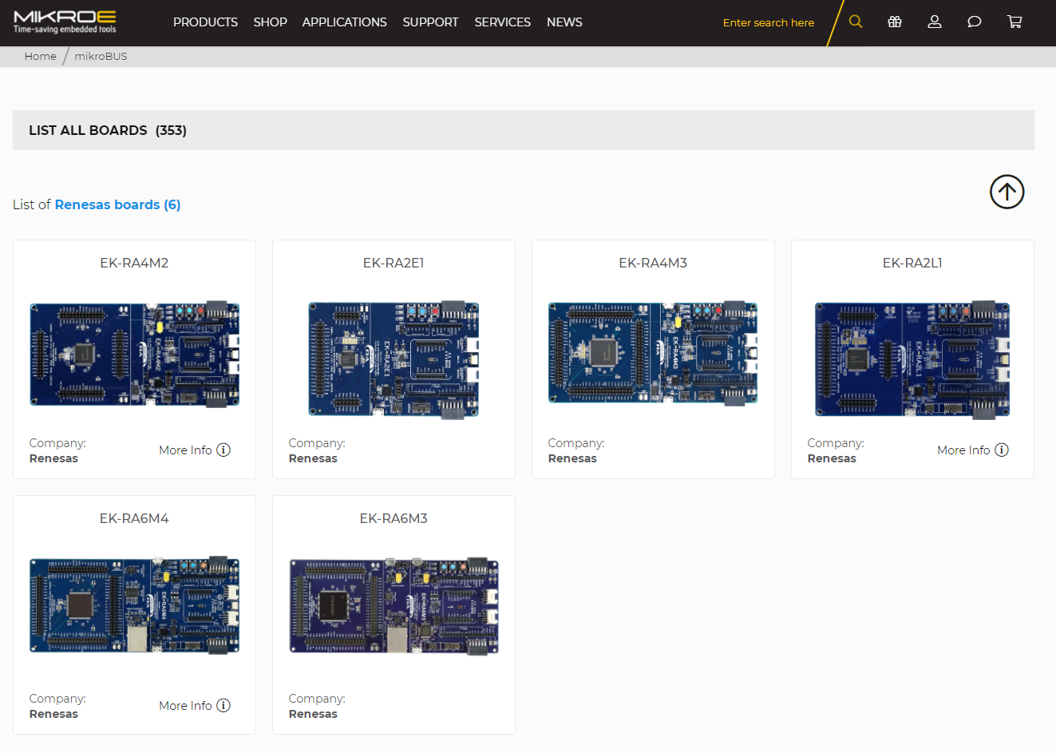
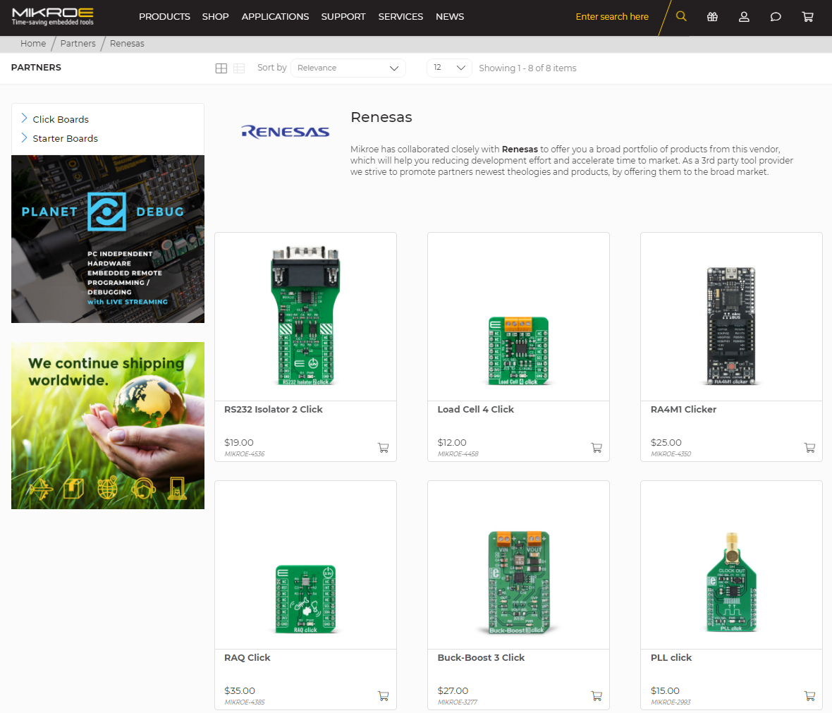
MIKROE & RENESAS KITS
Renesas Kits featuring mikroBUS connector
Mikroe Kits featuring Renesas parts

Slide 7
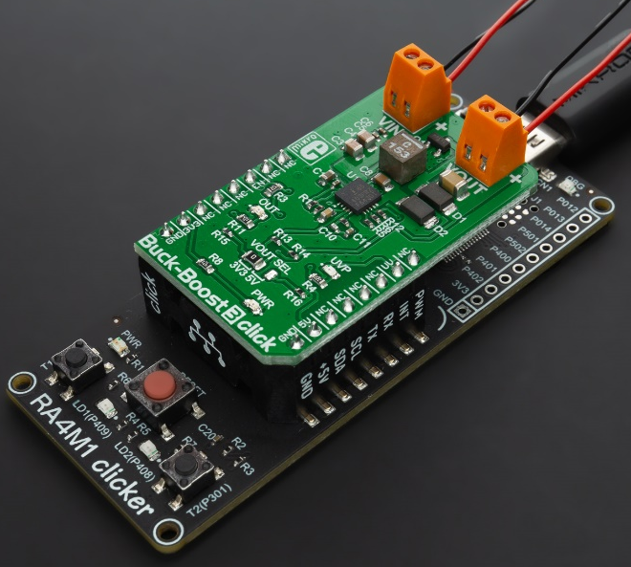
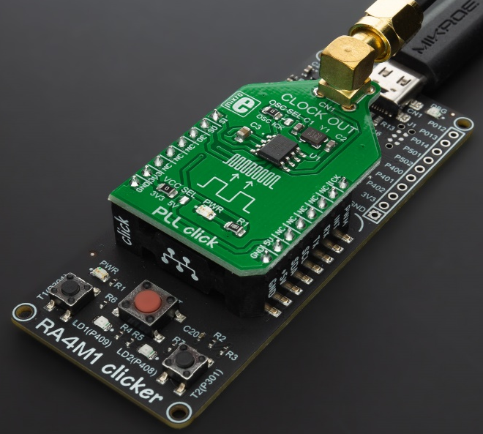
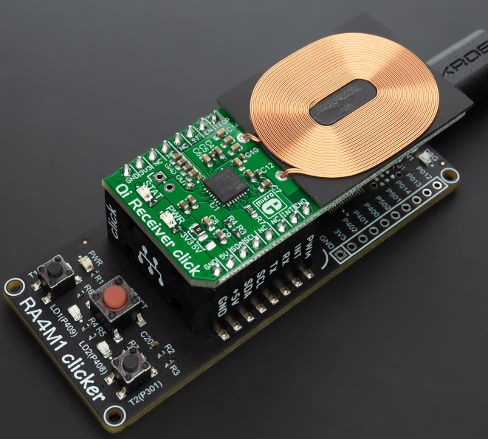
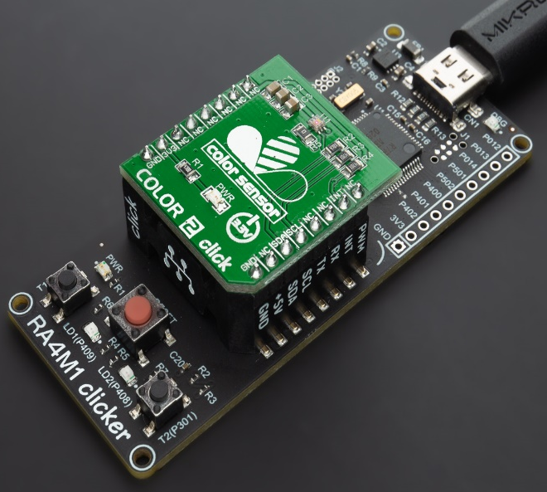


SOLUTION APPROACH
RA4M1 Clicker
+
Buck-Boost Click
(ISL85403)
RA4M1 Clicker
+
PLL Click
(ICS501)
RA4M1 Clicker
+
Receiver Click
(P9025AC)
RA4M1 Clicker
+
Color Click
(ISIL29125)

Slide 8
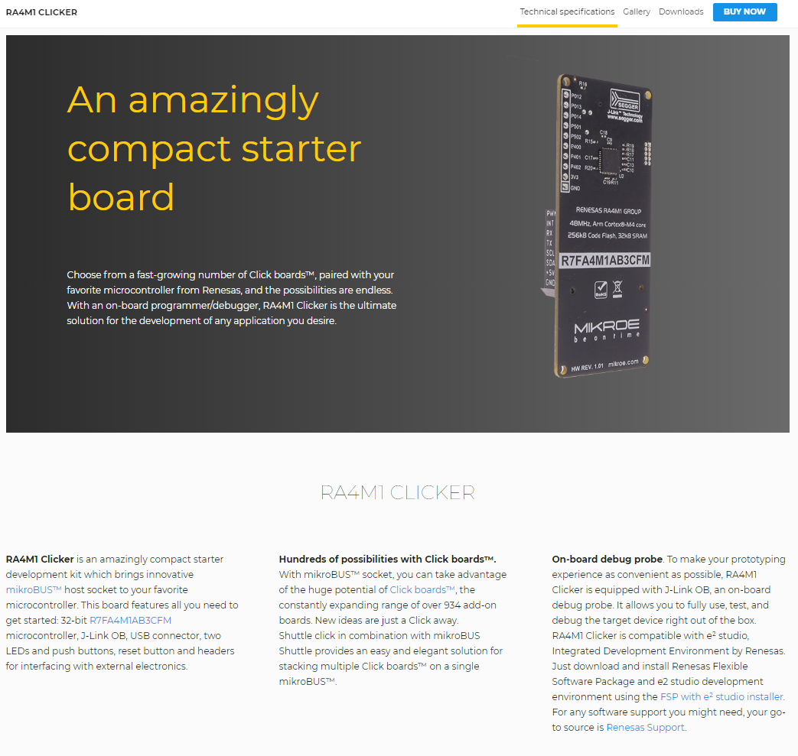

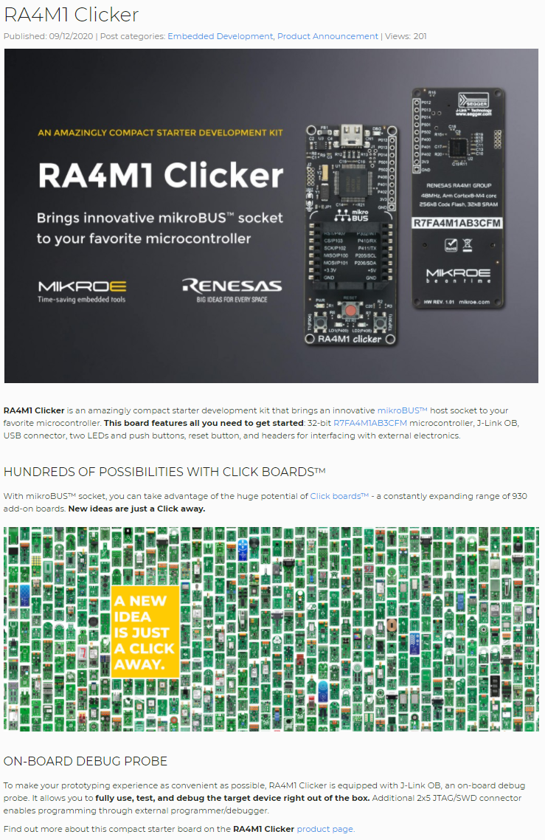
GLOBAL LAUNCH – DEC 9, 2021
Product Page
Press Release
Blog

Slide 9
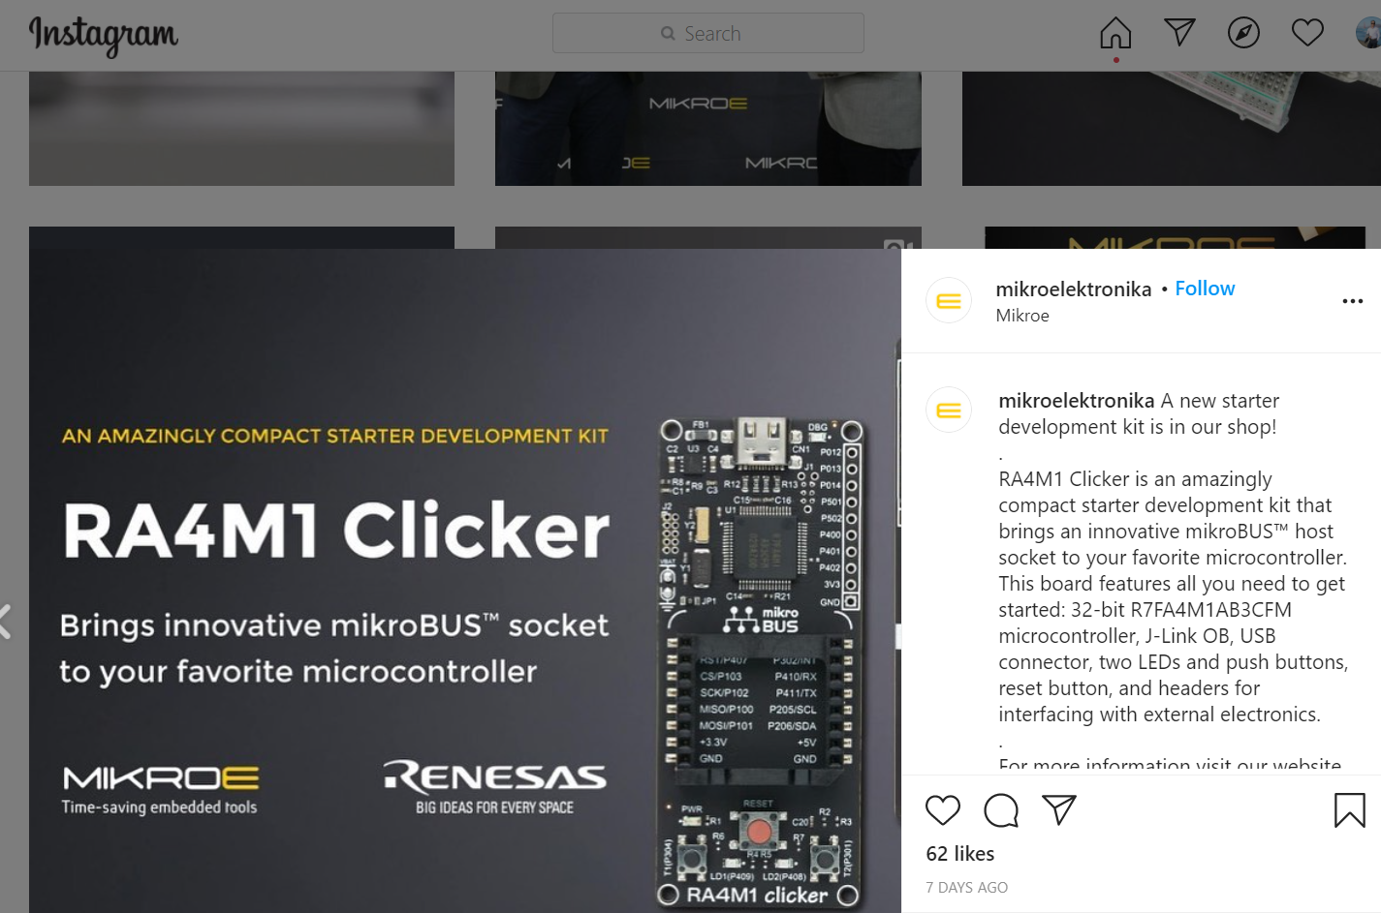
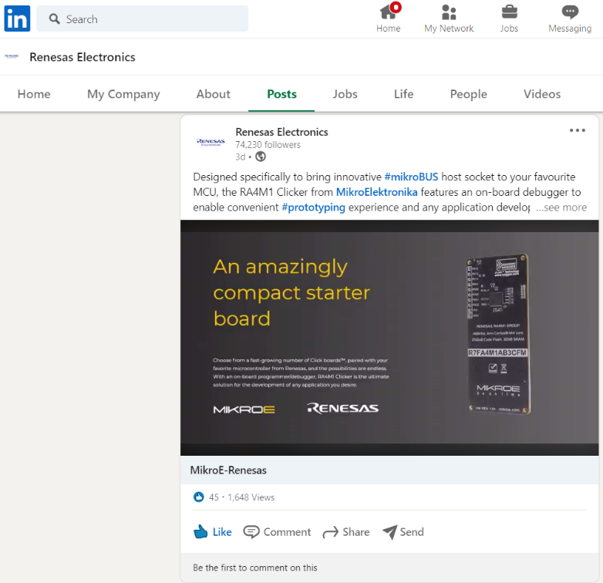
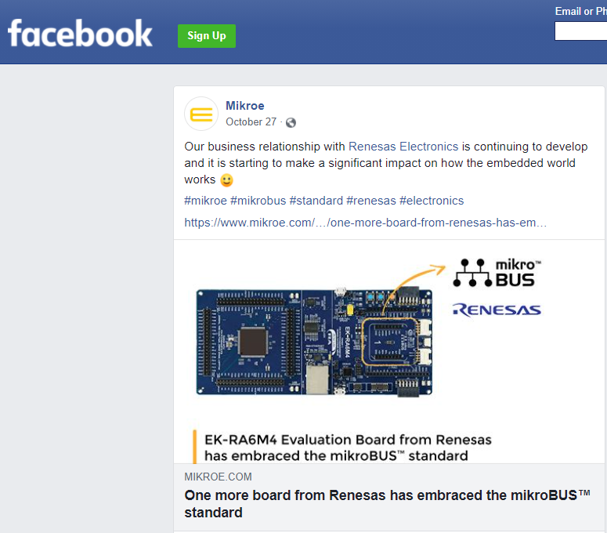
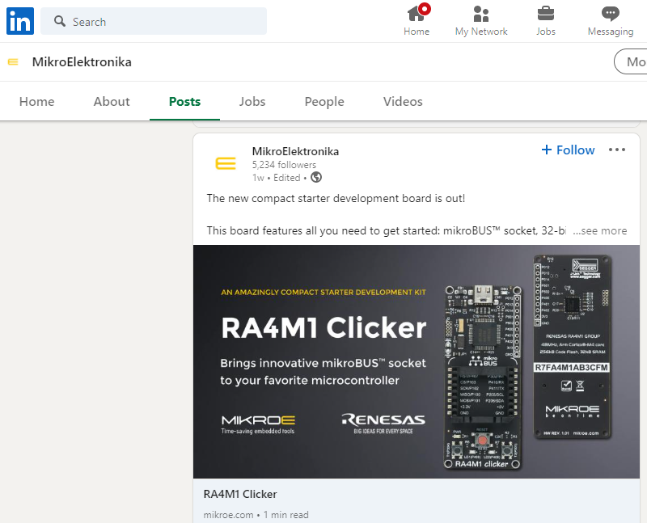
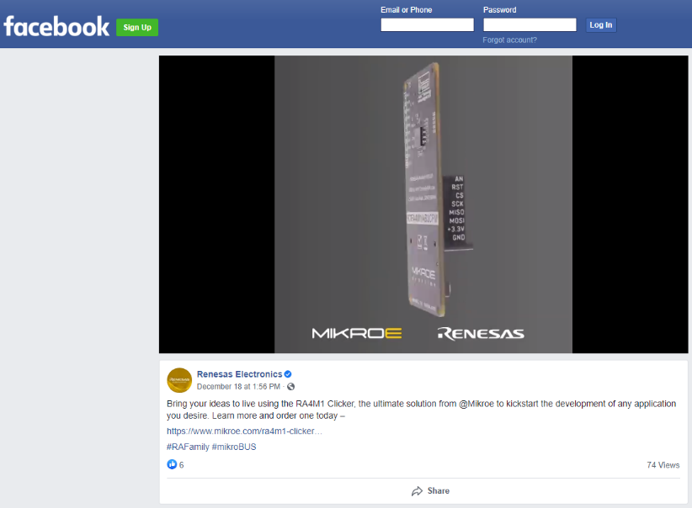
IN THE SOCIAL MEDIA…
Instagram | LinkedIn
Facebook

Slide 10
Renesas.com

